Slide 2
01.06.2023
Sonia
Analysis code
Pre-processing

Slide 3
06.06.2023
Background color - Black Done
Fixation point - White (Square) Done
Check 1st fixation point - 1000ms Done
Inter trial interval - 1 second(1000ms) Done
Self initiated trial - by spacebar Done
Pause data recording after 20 trial block Done
Check if there is calibration in every file Done
Check for high load/low load implementation Done

Slide 4
13.06.2023
Balanced trial - Done
Key response as left and right arrow
Gray to black background of object images. Done

Slide 5
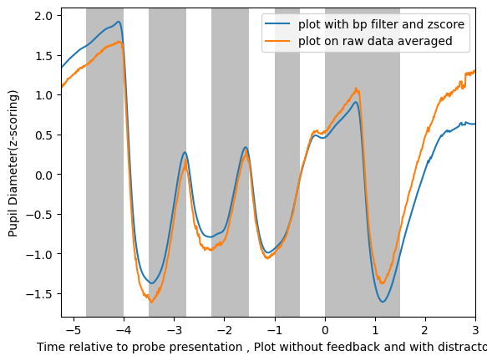
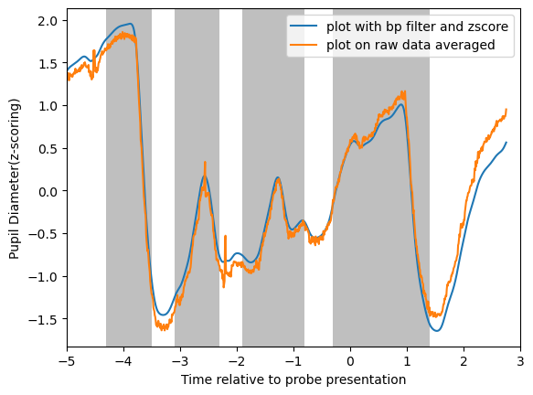
Nishchay8

Slide 6
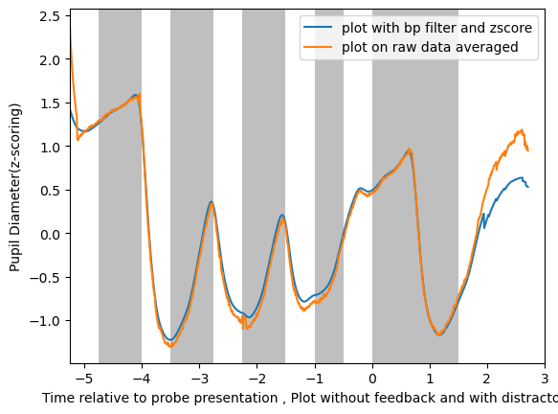
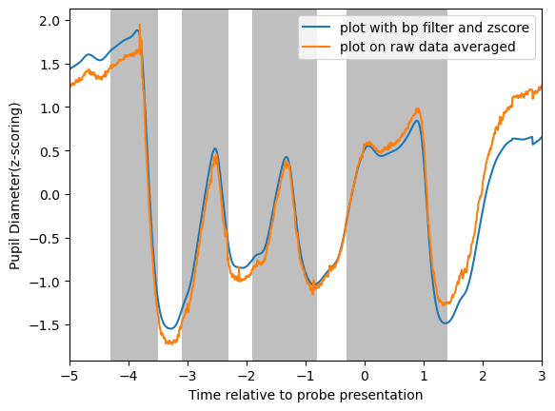
Nishchay7

Slide 7
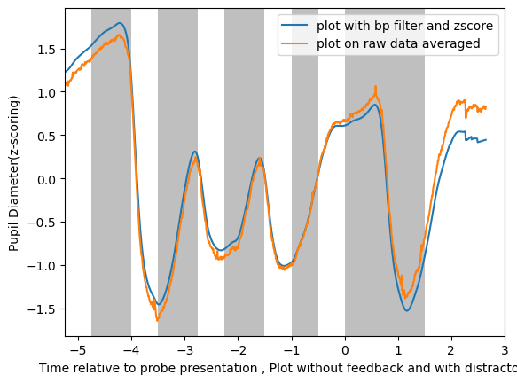
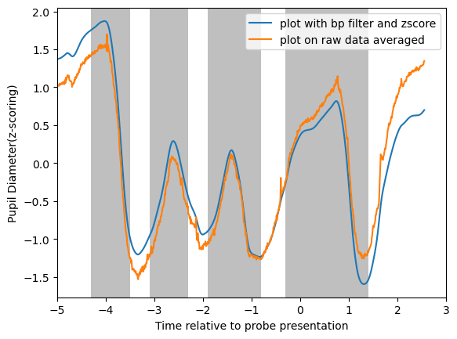
Nishchay6

Slide 8
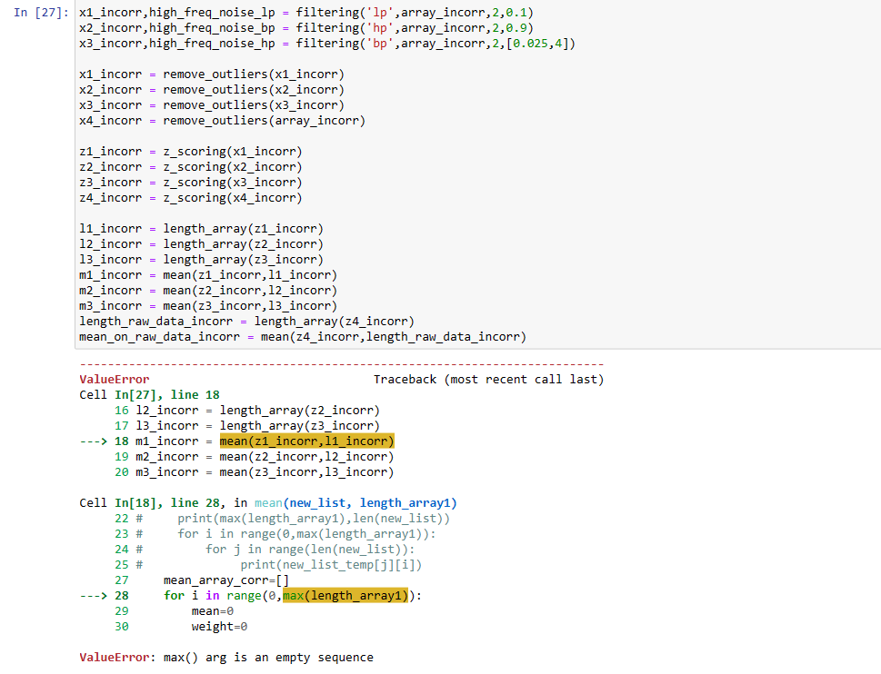
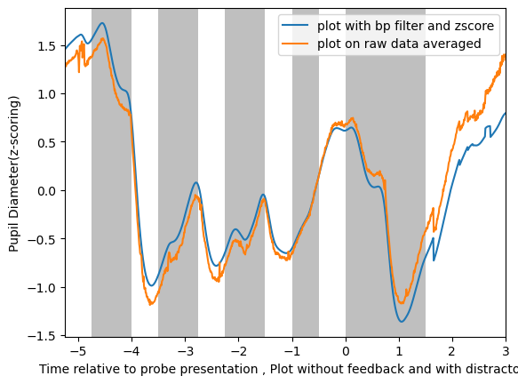
Nishchay5

Slide 9
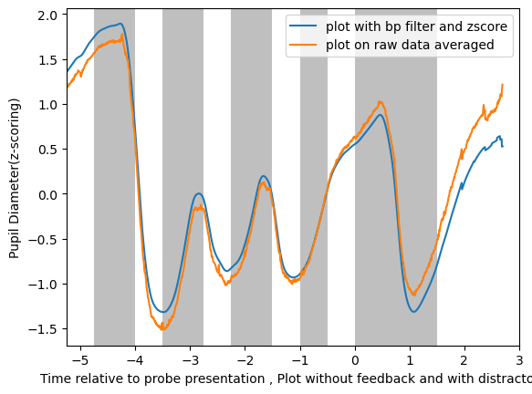
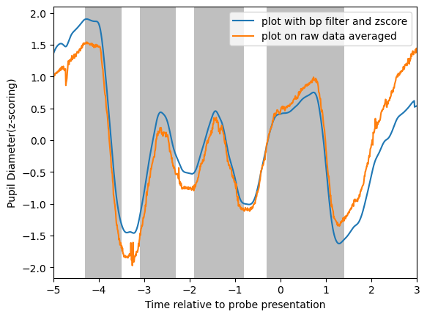
Nishchay4

Slide 10
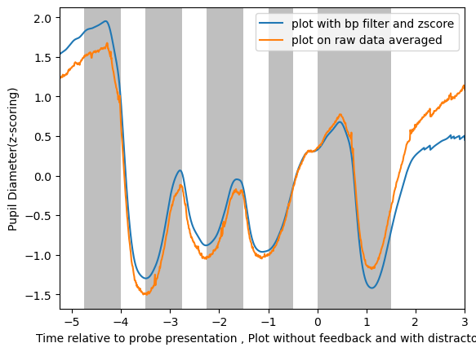
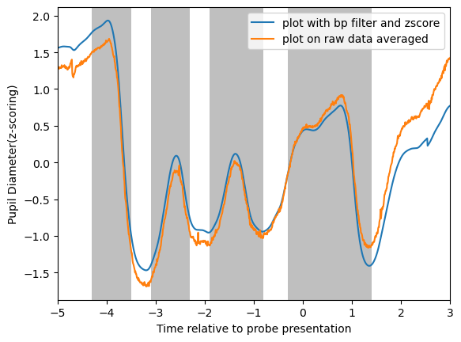
Nishchay3

Slide 11
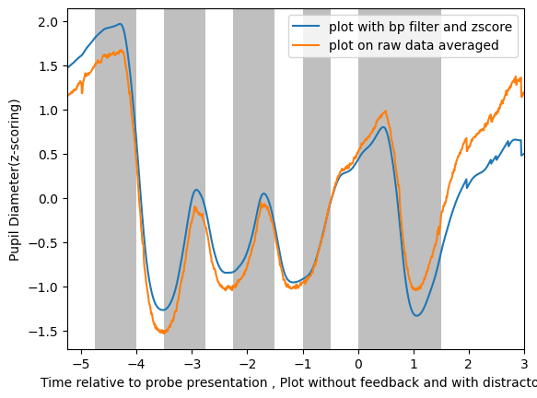
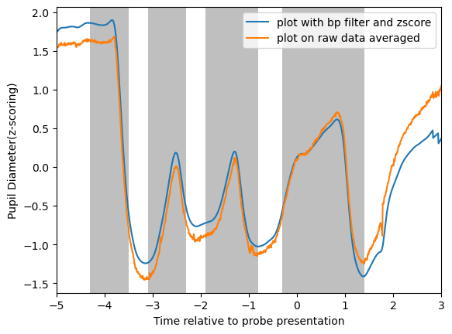
Nishchay2

Slide 12
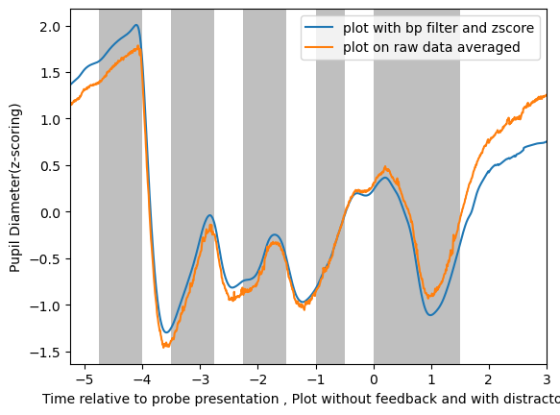
Nishchay1

Slide 13
Pre-processing pipeline (lakshita & Rahul)
Remove trial with > 50 % data missing / blinks
Detection of blink and missing data and remove them
Interpolate with spline (Wainstein, 2017)
Baseline correction: (100-400ms of fixation point onset)
bandpass Butterworth filter between 0.025 Hz and 4 Hz
Remove epochs with pupil dia > 3 standard deviation w.r.t mean (might not need)
Z score normalization trial by trial basis
N-back task for two participants pilot data

Slide 14
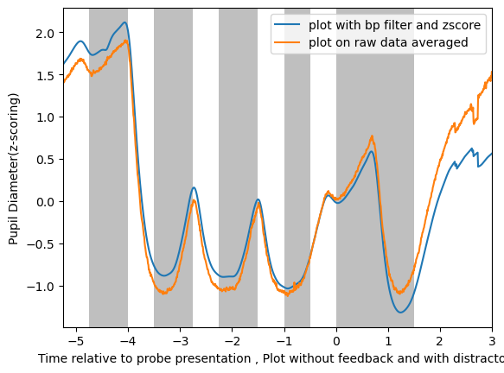
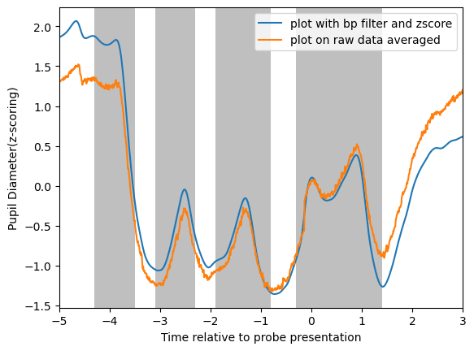
Manasi 1

Slide 15
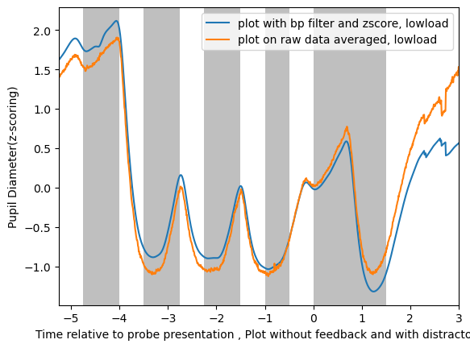
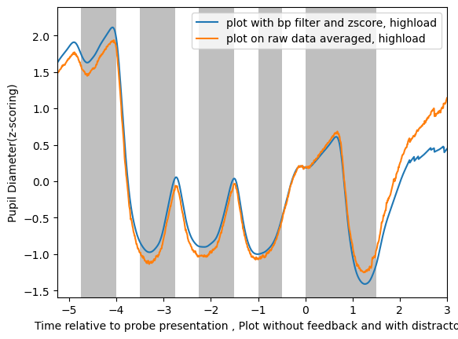

Slide 16
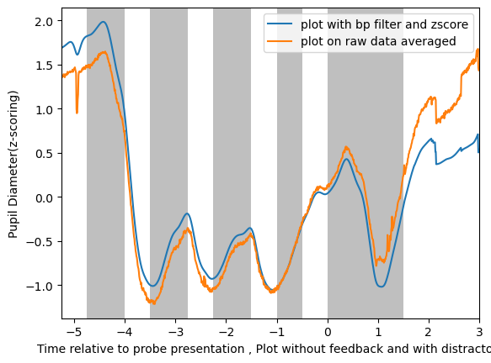
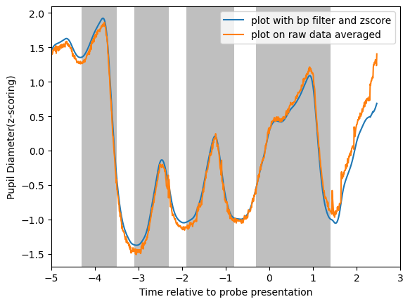
Manasi2

Slide 17
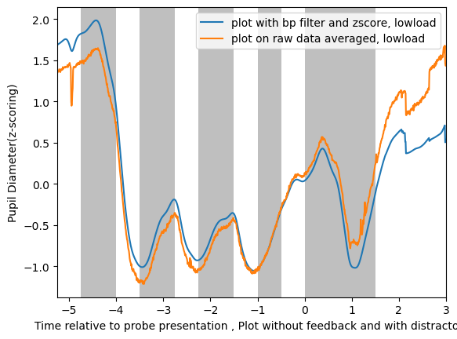
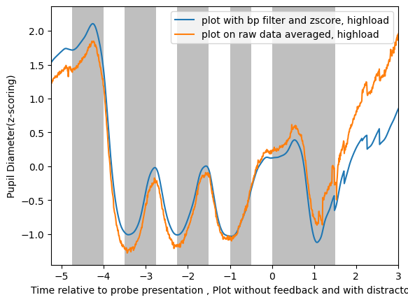

Slide 18
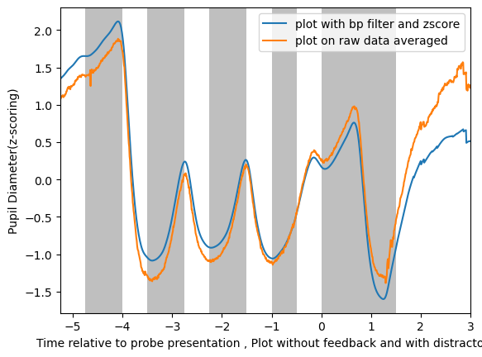
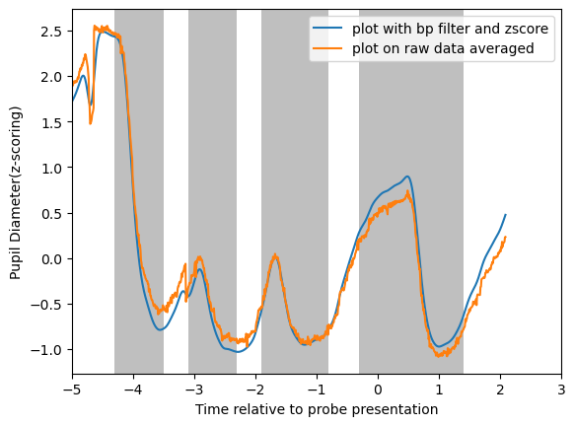
Manasi3

Slide 19
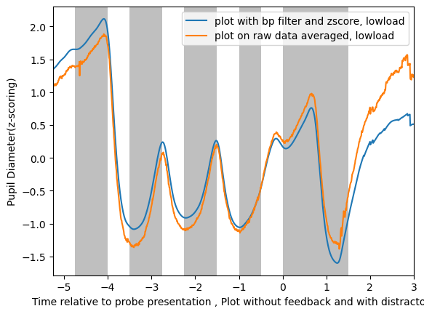
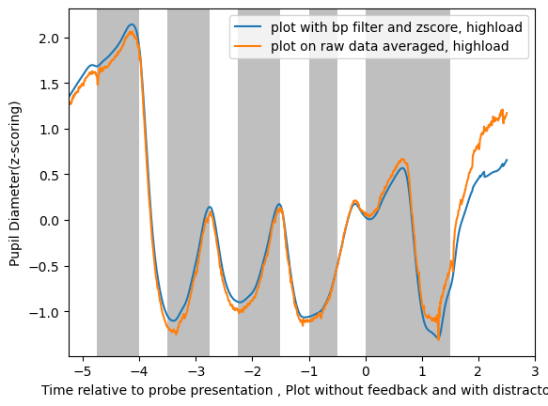

Slide 20
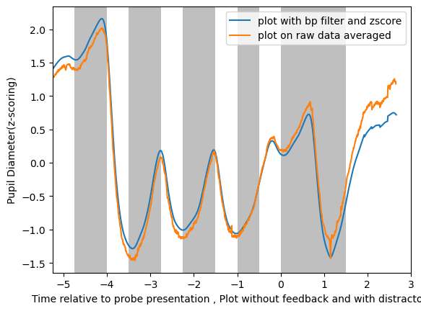
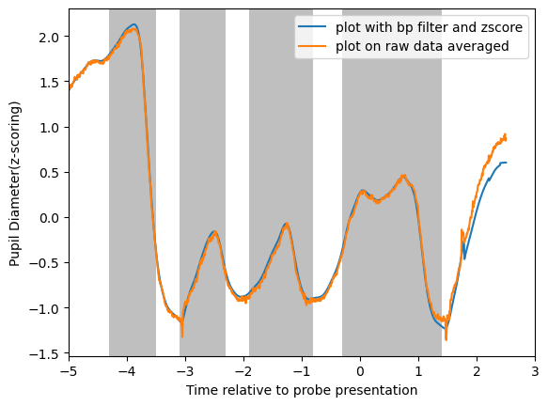
Manasi4

Slide 21
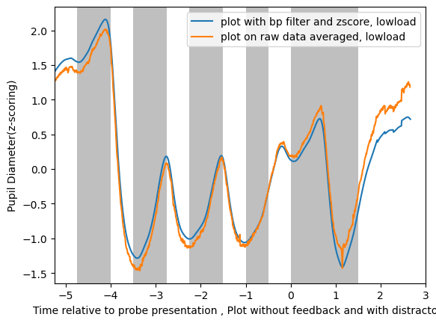
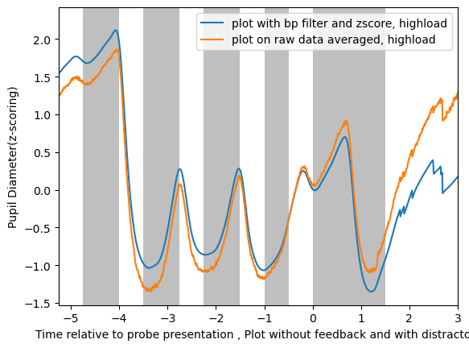

Slide 22
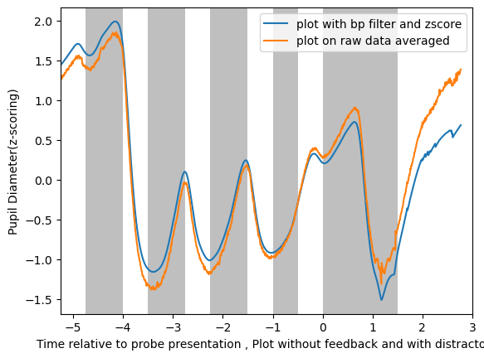
Manasi5

Slide 23
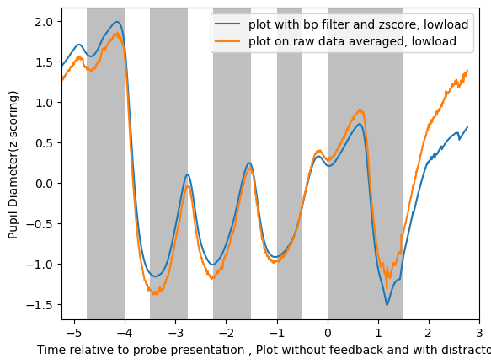
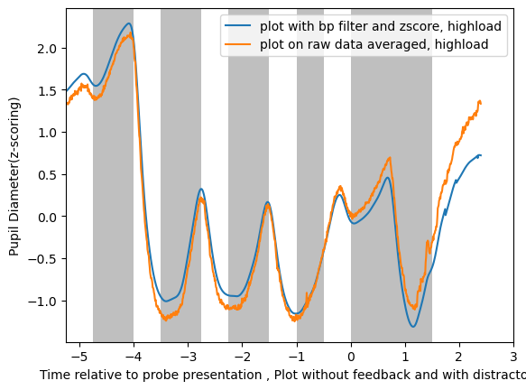

Slide 24
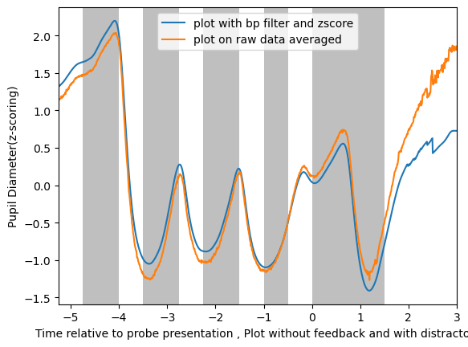
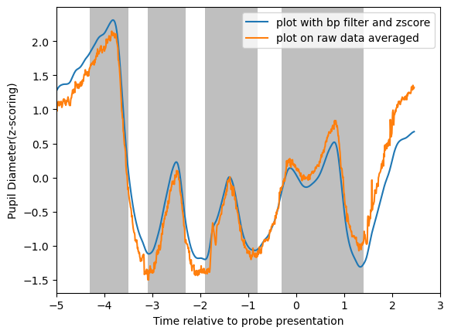
manasi6

Slide 25
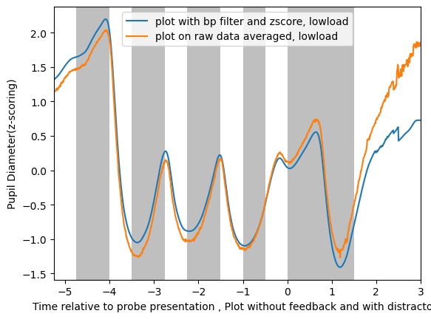
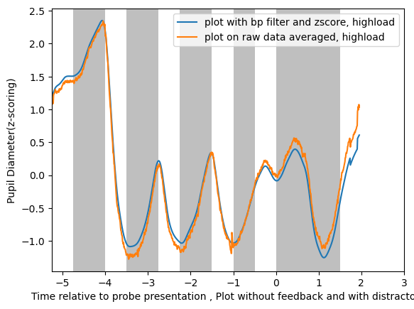

Slide 26
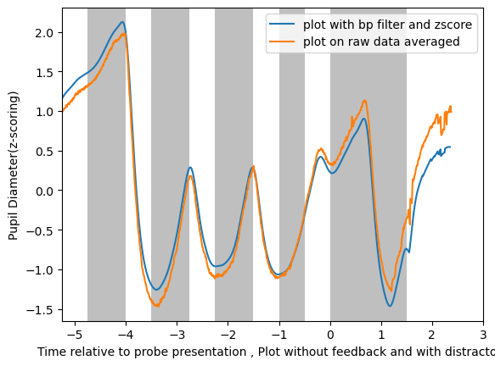
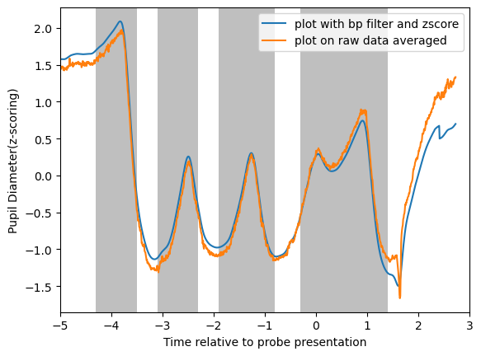
Manasi7

Slide 27
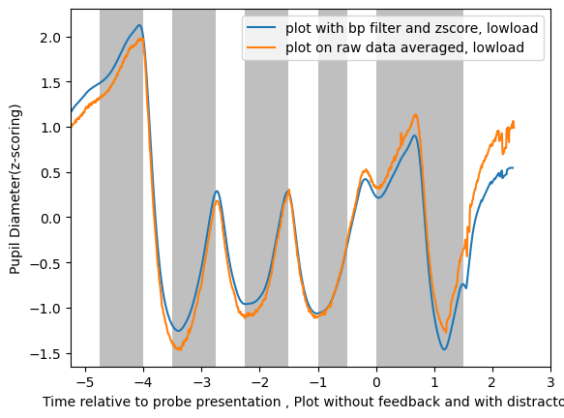
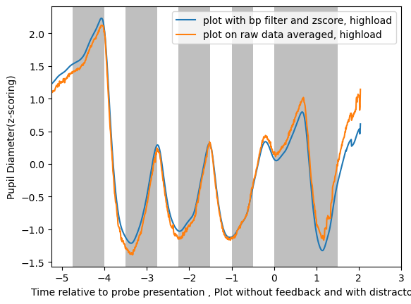

Slide 28
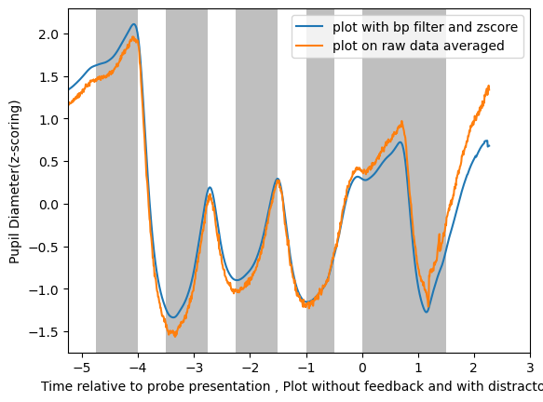
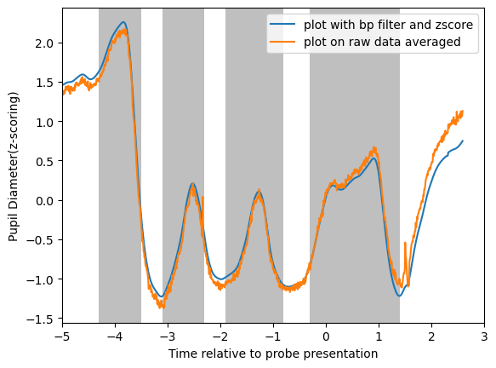
Manasi8

Slide 29
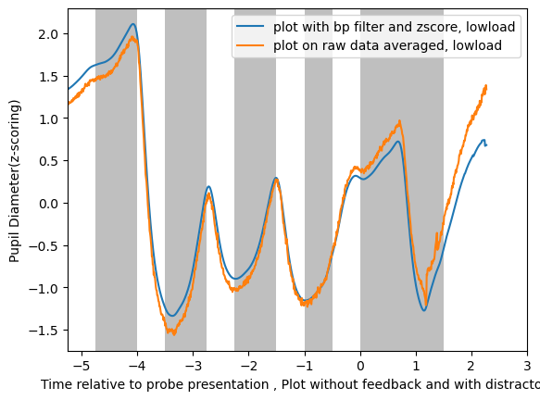
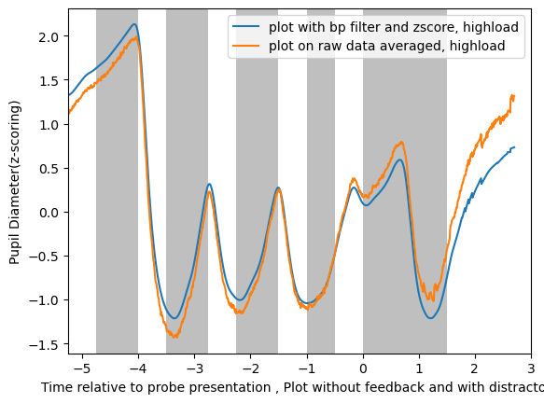

Slide 30
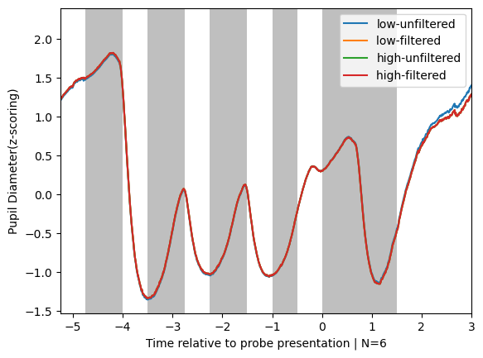

Slide 31
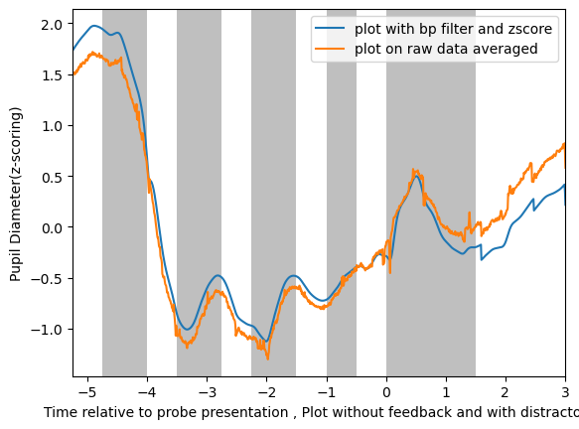
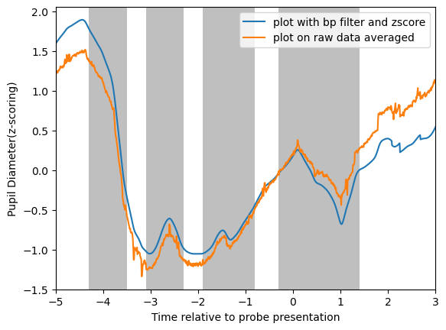
Shruti1

Slide 32
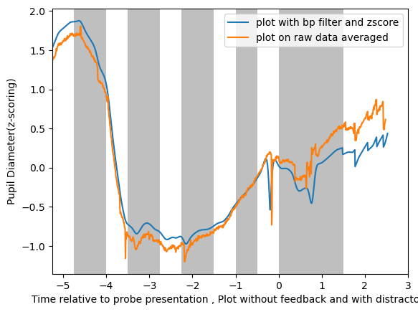

Shruti2

Slide 33


Shruti3

Slide 34


Shruti4

Slide 35


Shruti5

Slide 36


Shruti6

Slide 37


Shruti7

Slide 38


Shruti8

Slide 39


Medhavi8

Slide 40


Medhavi7

Slide 41


Medhavi6

Slide 42


Medhavi5

Slide 43


Medhavi4
Too many trials to be removed

Slide 44

Medhavi3
Trials_to_be_removed [0, 1, 2, 3, 4, 5, 6, 7, 8, 9, 10, 11, 12, 13, 14, 15, 16, 17, 18]

Slide 45


Medhavi2

Slide 46


Medhavi1

Slide 47


Harsh1

Slide 48


Slide 49


Harsh2

Slide 50


Slide 51


Harsh3

Slide 52


Slide 53


Harsh4

Slide 54


Slide 55


Harsh5

Slide 56


Slide 57


Harsh6

Slide 58


Slide 59


Harsh7

Slide 60


Slide 61


Harsh8

Slide 62


Slide 63


Vishal1

Slide 64

Vishal1: incorr

Slide 65


Vishal2

Slide 66

Vishal2

Slide 67


Vishal3

Slide 68

Vishal3

Slide 69


Vishal4

Slide 70

vishal4

Slide 71


Vishal5

Slide 72

Vishal5

Slide 73


Vishal6

Slide 74

Vishal6

Slide 75


vishal7

Slide 76

Vishal7

Slide 77


Vishal8

Slide 78


Slide 79


Aishani1

Slide 80


Slide 81


Aishani2

Slide 82


Slide 83


Aishani3

Slide 84


Slide 85


Aishani4

Slide 86


Slide 87


Aishani5

Slide 88


Slide 89


Aishani6

Slide 90


Aishani7

Slide 91


Slide 92


Aishani8

Slide 93


Slide 94


Nishchay:Average

Slide 95


Manasi:Average

Slide 96


Harsh:Average

Slide 97


Vishal: Average

Slide 98


Aishani: Average

Slide 99

Mean: Nishchay, Manasi, Harsh

Slide 100

Mean: Nishchay, Vishal, Harsh, Manasi

Slide 101

Mean: Nishchay, Vishal, Harsh, Manasi, Aishani

